Slide 1
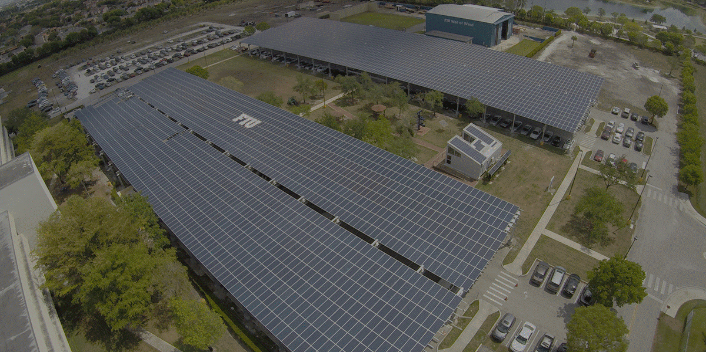
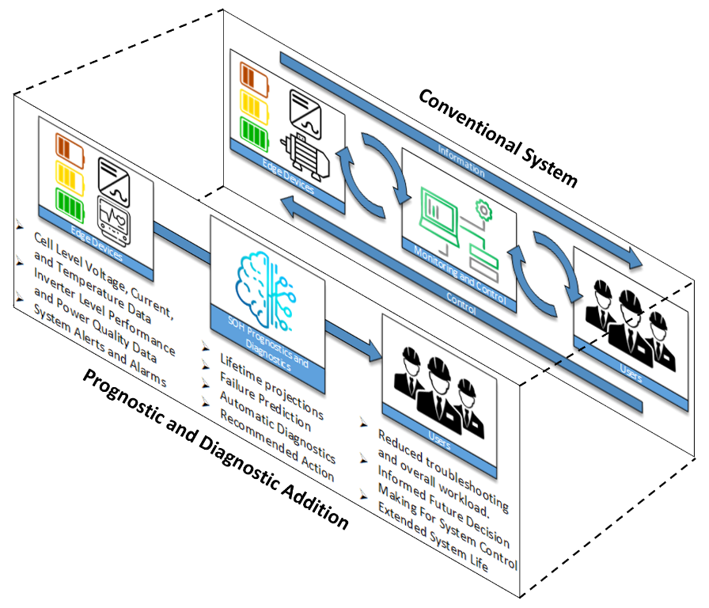
ML/RL-Based Battery Prognostic and Diagnostic Tool Development
Problem Statement: Li-Ion batteries benefit from a high-power density, high energy density, and a relatively good cycle life; However, as these batteries age from both operational as well as calendar degradation, the ability for them to hold charge, and produce power efficiently reduces. Although degradation cannot be completely prevented, accelerated degradation can be prevented through the proper monitoring and operation of battery systems. Battery Management Systems (BMS) and Thermal Management Systems (TMS) are used to avoid overcharging, undercharging, high current, and high temperature which drastically prolong the life of a Battery Energy Storage System (BESS). However, like State-Of-Charge (SOC), it may be difficult to precisely determine and monitor the State-Of-Health (SOH) of individual batteries, battery modules, or entire BESSs overtime. Luckily, Machine Learning (ML) and Artificial Intelligence (AI) techniques can be used to facilitate lifetime projections of the system over multiple scenarios, predict failures before they happen, automatically diagnose problems that arise, recommend appropriate action, and more.
Project Objectives and Approach:
Develop a robust full stack hybrid remote/cloud application for Multi-Environment Deployable Li-Ion Battery Prognostic and Diagnostic Tool
  Establish local development stack that will be used in an offline environment once deployed.
  Establish cloud platform and services that will be necessary for remote user interaction with the tool.
  Establish proper integration with local devices and cloud services that are necessary for project completion.
Establish and Develop Relevant ML and RL-Based Controls and Monitoring Tools for Inclusion into overall product
  Create list of features and functions that should/are possible to be included in the hybrid system.
  Determine relevant existing ML and RL tools that can be used for features and functions identified in Task 2a. What can be used on the edge? What needs to be done on the cloud?
  Develop and Implement ML/RL tools into battery tool stack infrastructure.
Validation and Deployment in Real-World Battery Application(s)
  Conduct numerous tests to evaluate the performance of the ML/RL based Prognostic/Diagnostic tool.
  Deploy tool to real battery pack and conduct life cycle analysis of battery pack and observe performance of tool.
GENIE Lab – Florida International University (FIU)
Project Team | Arif Sarwat (Mentor), Alexander Stevenson (Co-Mentor)
Labs | Florida International University (FIU)
Partners | Senior Design Team #
Duration | SUM 2025 – FALL 2025
Prototypical ML/RL-Based Battery Prognostic Tool being developed in the GENIE Lab
Florida International University – Department of Electrical and Computer Engineering – Energy Power Sustainability & Intelligence

Slide 2


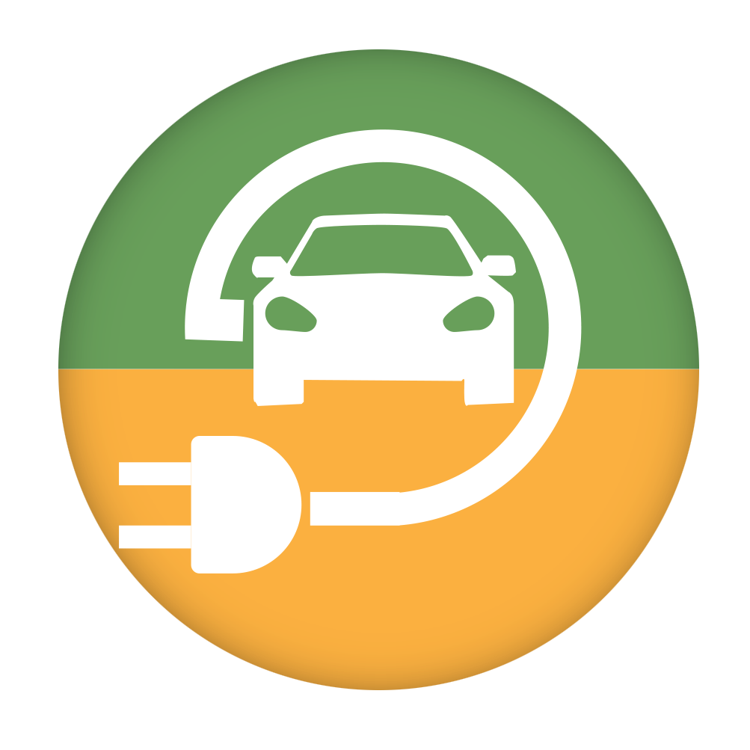






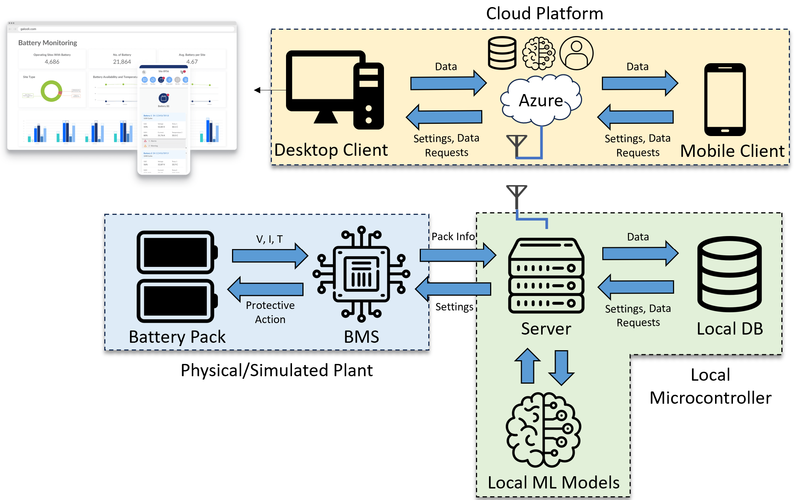
Tasks and Deliverables Overview
Key Senior Design Objectives:
Multiple Applications: Capable of monitoring and managing stationary or non-stationary Li-Ion battery storage applications as well as be used in multiple different modes of transportation
Senior Design 1:
Task 1: Follow the Project Start Guide Provided by the Previous Team to implement the Previous Set up.
  Subtask 1.1: Build the Physical Hardware Environment as Described in the Project Start Guide.
  Subtask 1.2: Build the Cloud/Code Environment as Described in the Project Start Guide.
  Subtask 1.3: Implement the Variable (EV Scooter Motor) Load instead of the static resistors.
Deliverable 1: A complete (wired) bidirectional communication between/from user to battery pack with a variable load instead of static load. Should be able to complete a complete demo of hardware/software system.
Task 2: Investigate cloud/hardware changes needed to implement a battery charger and a cell connection to cloud.
  Subtask 2.1: Create a list of required hardware to be ordered (Include power supply!).
  Subtask 2.2: Create a list of required hardware/cloud applications to be integrated.
  Subtask 2.3: Create a plan of actions to be followed in SD2 to complete charger/cell connection.
Deliverable 2: A full plan for battery charger and cell connection integration with current hardware and cloud infrastructure.
Designed with remote deploy-ability in mind: Works with or without internet access for flexible operation in multiple environments.
Senior Design 2:
Task 3: Implement charger/cell connection integration plan with hardware + cloud infrastructure.
  Subtask 3.1: Implement required hardware changes for cell connection.
  Subtask 3.2: Implemented required cloud infrastructure changes for cell connection.
  Subtask 3.3: Test stand alone devices in multiple (and different types of) locations.
Deliverable 3: A complete (wireless) bidirectional communication between/from user to battery pack.
Task 4: Improve/increase user functions/BMS commands in the Online UI.
  Subtask 4.1: Investigate functionality/profiles of BMS for protecting/controlling the relays/batteries.
  Subtask 4.2: Add ability for user to make changes to battery profile/control settings from the online UI.
  Subtask 4.3: Demonstrate complete wireless system, charging/discharging, UI monitoring/Control, etc.
Deliverable 4: Improved functionality/capability of the battery P&D tool.
Florida International University – Department of Electrical and Computer Engineering – Energy Power Sustainability & Intelligence
Notes:
Additional Objective may be to improve upon the existing ML application and add a new one (automated data cleaning/anomaly detection) on the rasp pi.

Slide 3
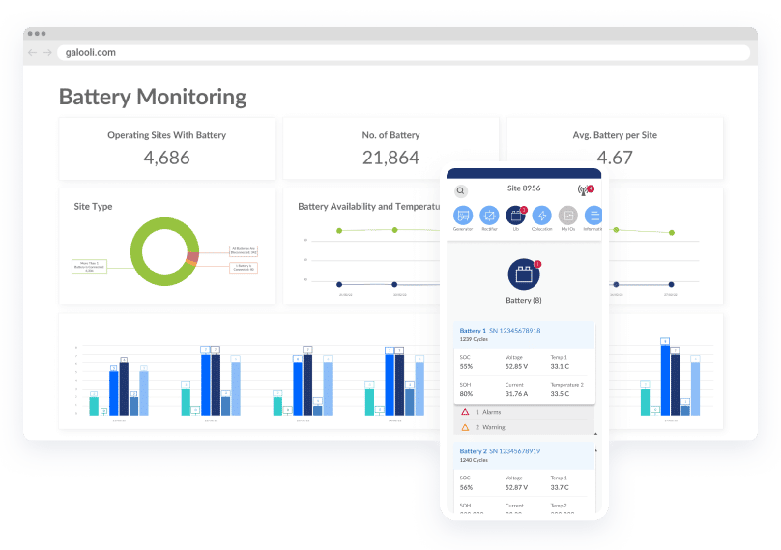








Proposed Battery Tool Deployment Communication Overview
Cloud Platform
Data
Cloud
Settings, Data Requests
Desktop Client
Charger
V, I, T
Pack Info
Data
R
Variable Load
R
Settings, Data Requests
Protective Action
Settings
Battery Pack
BMS
Server
Local DB
Physical/Simulated Plant
Local Microcontroller
Local ML Models
Florida International University – Department of Electrical and Computer Engineering – Energy Power Sustainability & Intelligence

Slide 4
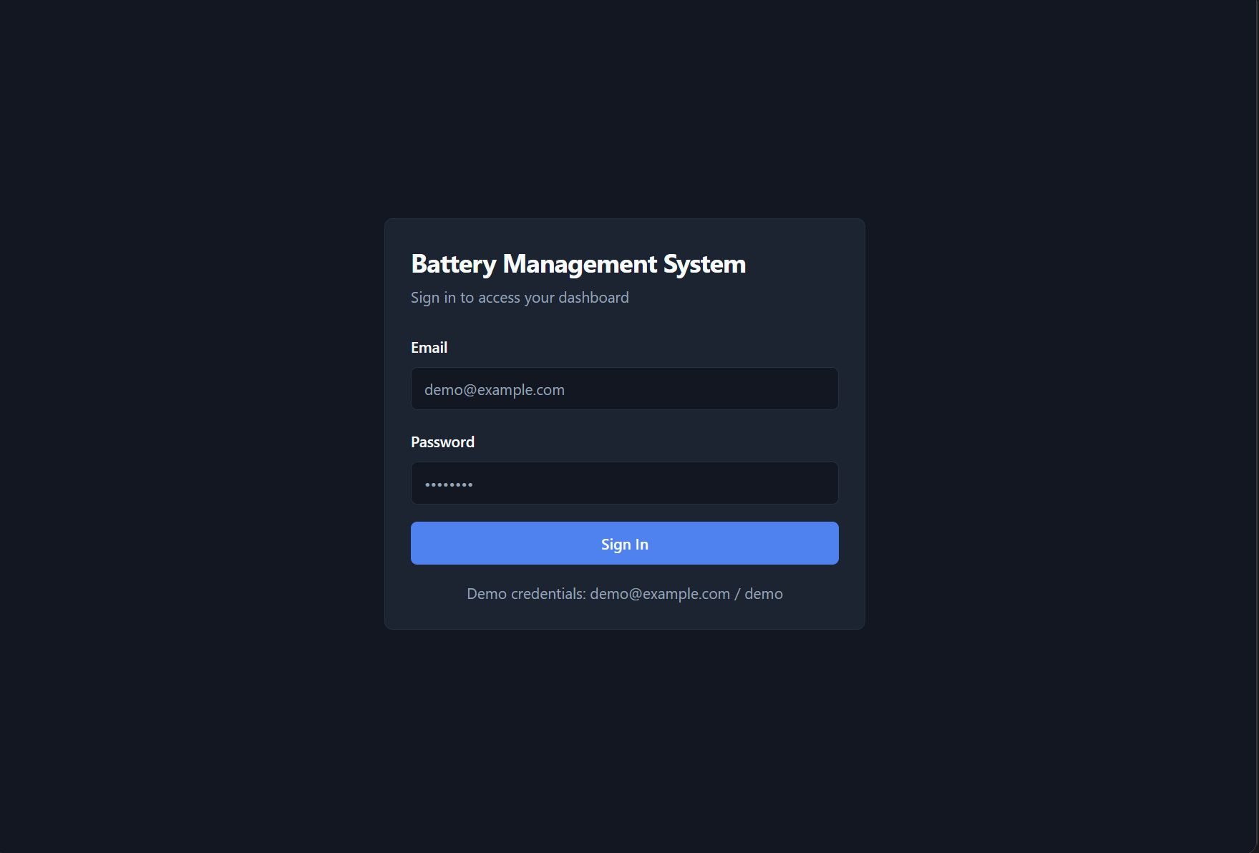
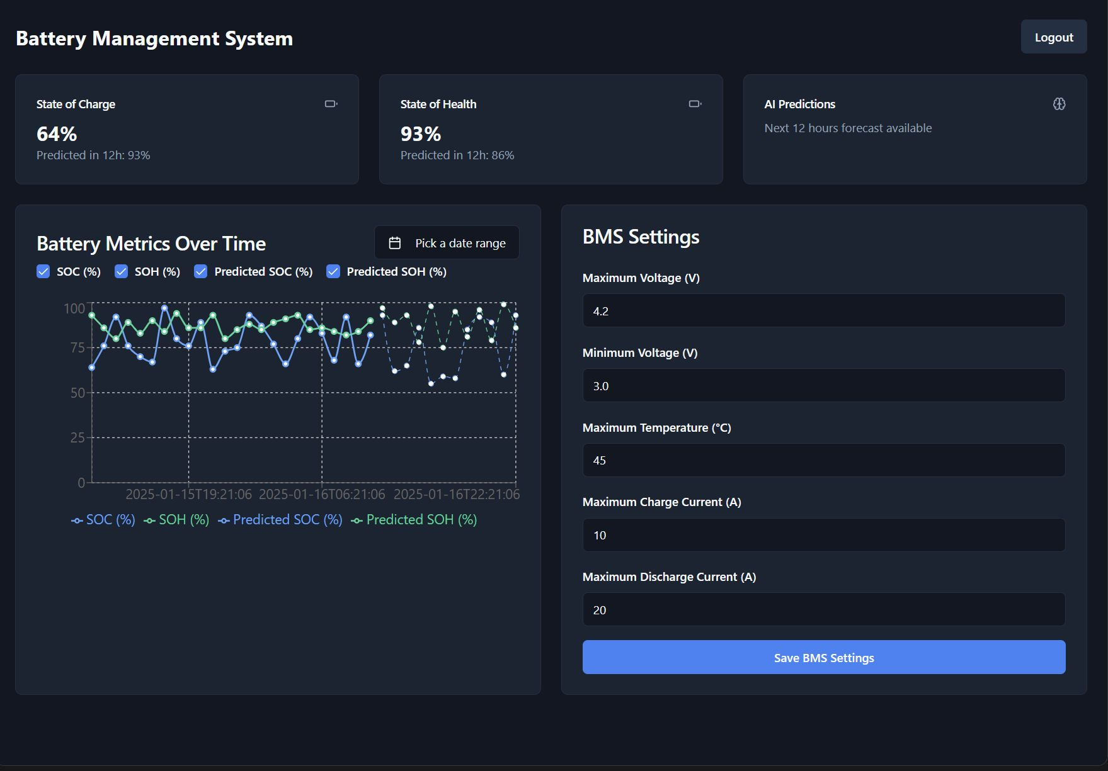
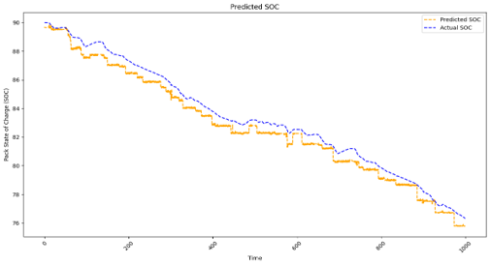
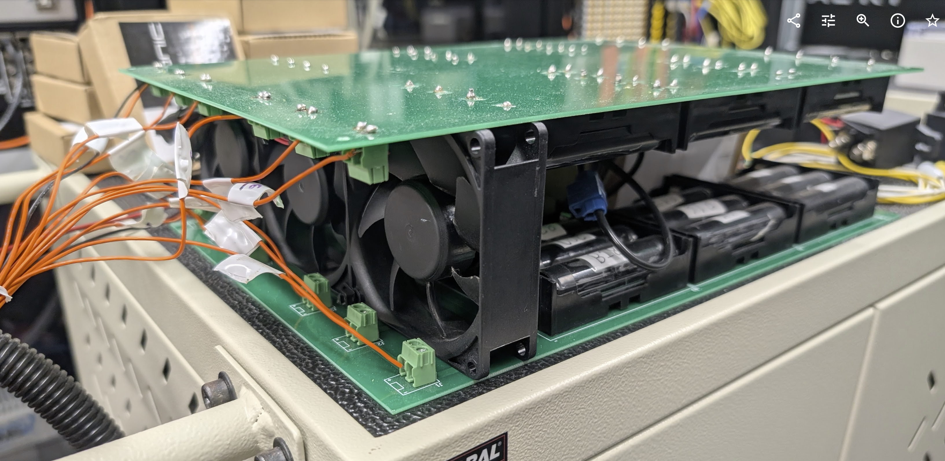
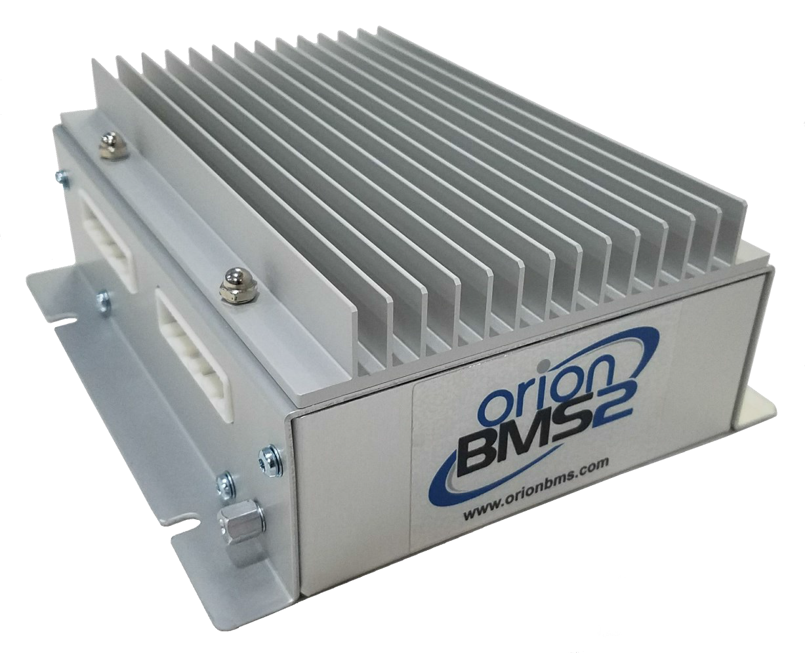
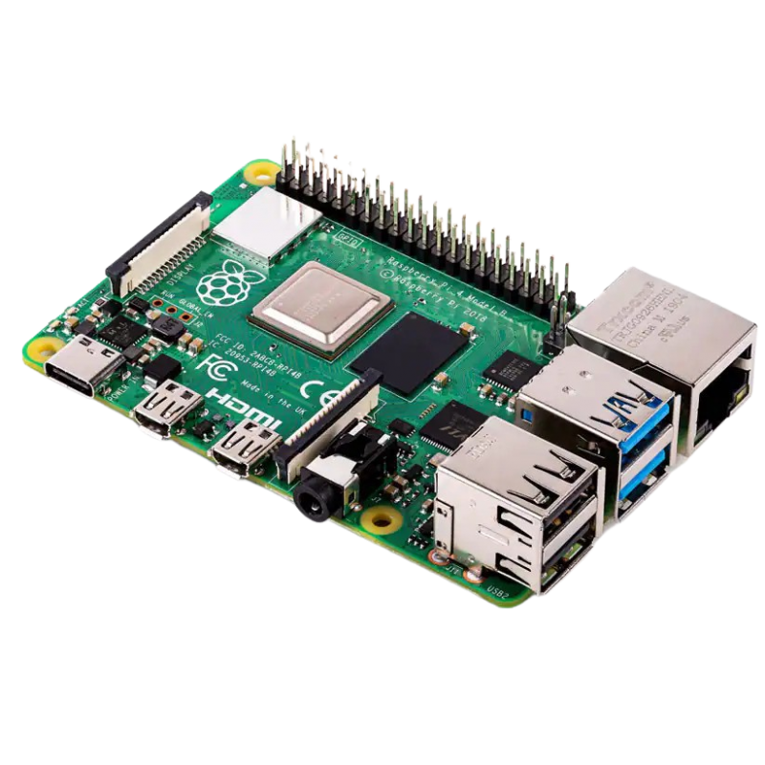
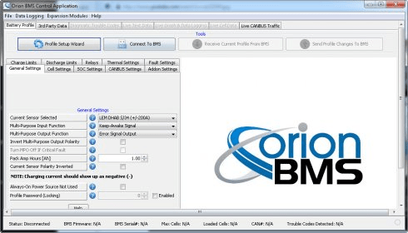
Current Battery Tool Deployment Communication Overview
Cloud Platform
Data
AWS
Settings, Data Requests
Desktop Client
Charger
V, I, T
Pack Info
R
Probes
CANBUS
Static Load
R
Protective Action
Settings
Battery Pack
BMS
Server
Physical Plant
Local Microcontroller
Florida International University – Department of Electrical and Computer Engineering – Energy Power Sustainability & Intelligence

Slide 5
